Slide 1


Comprehensive
Background Check Solutions
Welcome to IDA, your trusted partner in ensuring a secure and compliant workforce
www.idaautomation.com

Slide 2








OUR STORY
Started operations in 2016
2024
2024 Over 40+ services
Supporting back-office functions for US clients
Offering BGV services
2022
2020 Offering 25+ services
700+ employee base
2022
Employee base reaches 550+
ISO Certifications
Onshore sales and support unit based out of
Orlando, FL
2018
300+ employees 2nd Unit
Expertise in BGV, Large Language Model and
Robotic Process Automation
ISO 27001 (ISMS) & 9001 (QMS)
2016
Started Operations in India and US
SOC 2 Type 1 ready
OurMission
“ Evolving innovatively, Growing exponentially, Building enduring relationships"
02

Slide 3




9+
850+
WHY IDA?
Years of Experience
Customers
Ensuring integrity and trust
Through Comprehensive
Background Checks
30+
10+
Countries Reach
Industries Served
03

Slide 4
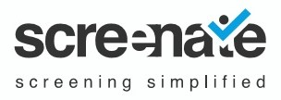
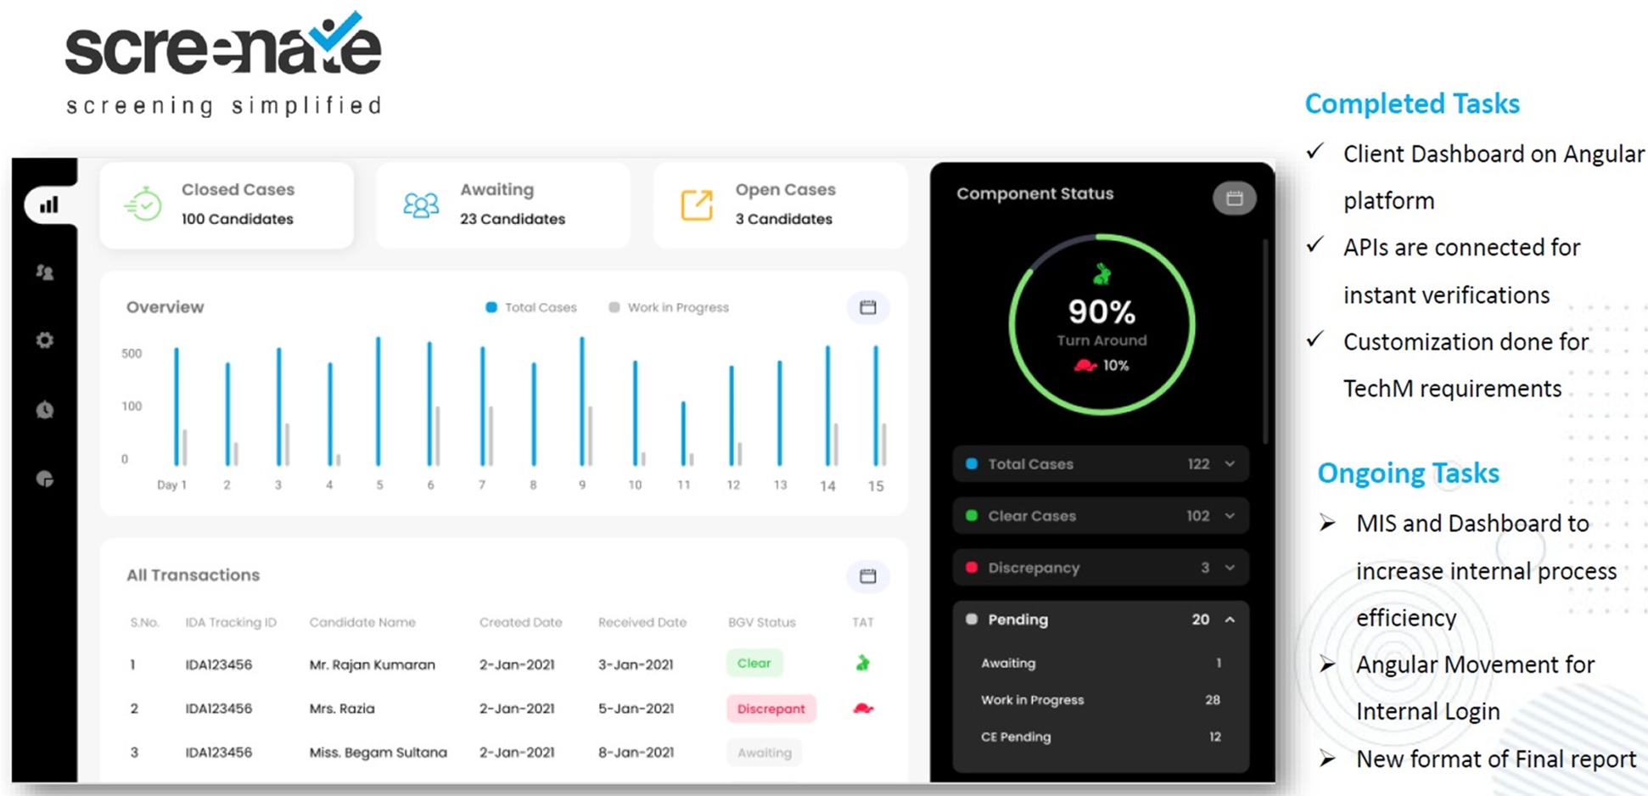



WHY IDA?
Advanced Background Screening Solution
Real time, most flexible, cutting edge and future
ready background check experience
100% Transparency
Upto 80% Faster TAT
Holistic view of entire employee background verification journey
Accelerate background verification process to meet SLAs
Near 100% Accuracy
Comprehensive background checks to build trust with data
04

Slide 5






IDA’s SPECIALIZED CHECK
SOCIAL MEDIA CHECK
CREDIT CHECK
GAP VERIFICATION
Check if the individual has
created negative publicity
for his/her ex-employer on
social media
Evaluate the credit discipline
of the individual
Gaps in a candidate’s
employment history is verified
to cross-check the cause for
the gaps
OFFER SHOPPER ALERT
MOONLIGHTING CHECK
STATEMENT CHECK
INTELLIGENCE
We detect if a candidate is
actively looking for new jobs, helping you identify
potential risks
We implement UAN and Form 26 AS verification to identify potential dual employment.
We assess financial statements,
PF interval/stop intelligence,
and bank statements for inconsistencies
06

Slide 6








PRIMARY CHECKS
ADDRESS
CHECK
IDENTIFICATION
CHECK
EDUCATION
CHECK
Validation of current and permanent address
Validation of ID based on government issued documents/cards
Validation of academic credentials
CRIMINAL
CHECK
EMPLOYMENT
CHECK
REFERENCE
CHECK
Reporting any criminal/civil case filed against the candidate.
Validation of genuineness of
earlier employment
Conducted through the reporting authority of the individual during their previous employment
DRUG
TEST
DATABASE
VERIFICATION
Check if the candidate is subject
to drug abuse. Involves various levels of tests
Track and report negative candidate's in public/proprietary database.
07

Slide 7














Market Segments Covered
HEALTHCARE
EDUCATION
BANKING
HOSPITALITY
IT & TECH
CONSTRUCTION
MANUFACTURING
LOGISTICS
REAL ESTATE
TELECOMMUNICATIONS
RETAIL
LEGAL
ENERGY
AVIATION
08

Slide 8
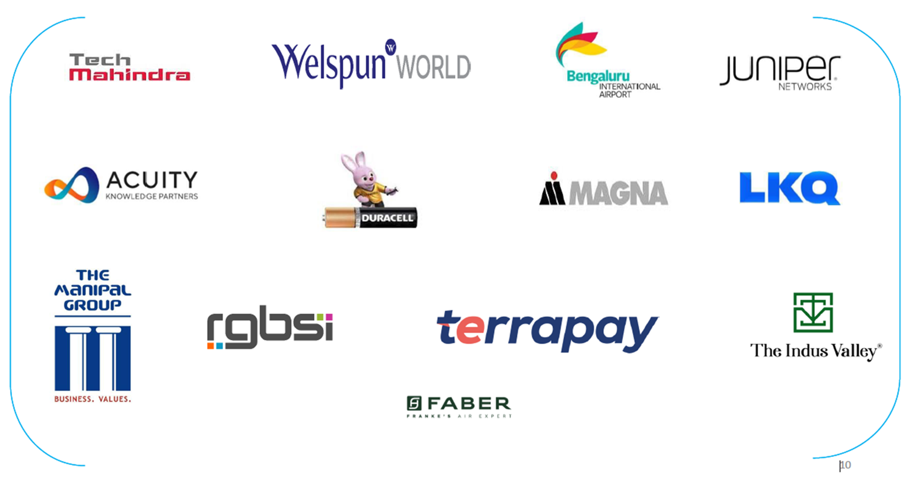
MARQUEE clients
14

Slide 9
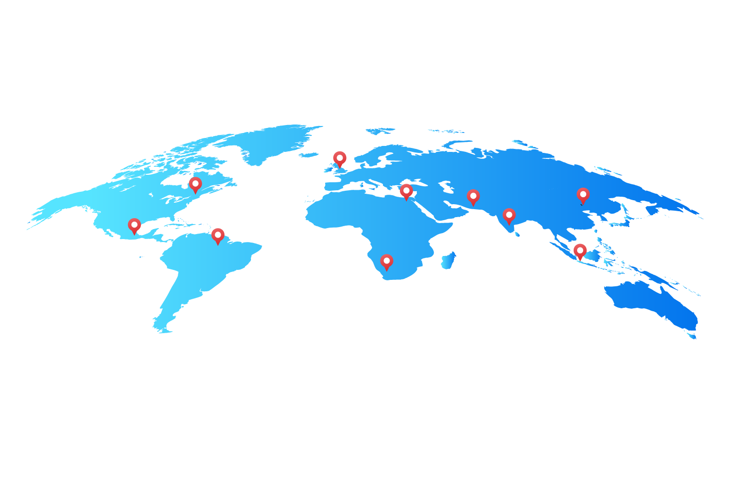
Global service footprints
Our Reach
North America: USA, Canada, Mexico
Europe: UK, Germany, France
Asia-Pacific: India, Philippines, China, Japan, Australia, Singapore & Sri Lanka
Worldwide coverage for efficient verification
15

Slide 10
THANK YOU
Contact US
Mail id : clientservices@idaautomation.com / Hemavathy.v@idaautomation.com
Mobile : 9986752450 / 6297880798 / 7975270966
India Office:
US Office:
Philippines Office:
IDA Automation Pvt Ltd
12th Floor, Brigade Metropolis Summit A, Near Garudachar Palya Metro Railway Station, ITPL Road, Whitefield, Mahadevapura, Bengaluru,
Karnataka - 560048
IDA Automation Inc
600 Rinehart Road,
Suite 3118, Lake Mary, FL 32746
IDA Automation Inc
16th floor, 6789 Tower, 6789 Ayala Avenue, Makati City 1209, Philippines.
www.idaautomation.com

